Slide 1

Be Fighting
Jude
Dr. Rick Griffith • Crossroads International Church
CICFamily.com • BibleStudyDownloads.org

Slide 2
Are you a fighter?
What are you willing to fight for?
To what lengths are you willing to fight for your rights?
To what lengths are you willing to fight for the gospel?
Notes:
Give a “yes” or “no” answer to the person next to you.

Slide 3

Apostates Destroy From Within
The Men who Destroyed the Christian West
Notes:
Believers have failed to fight apostasy the past 200+ years.
Apostates are unbelievers who live among the saints and destroy the church within. This has happened significantly in what used to be called the "Christian West."

Slide 4
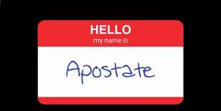
Apostates don't wear nametags
Notes:
Too bad apostates don’t wear nametags!

Slide 5
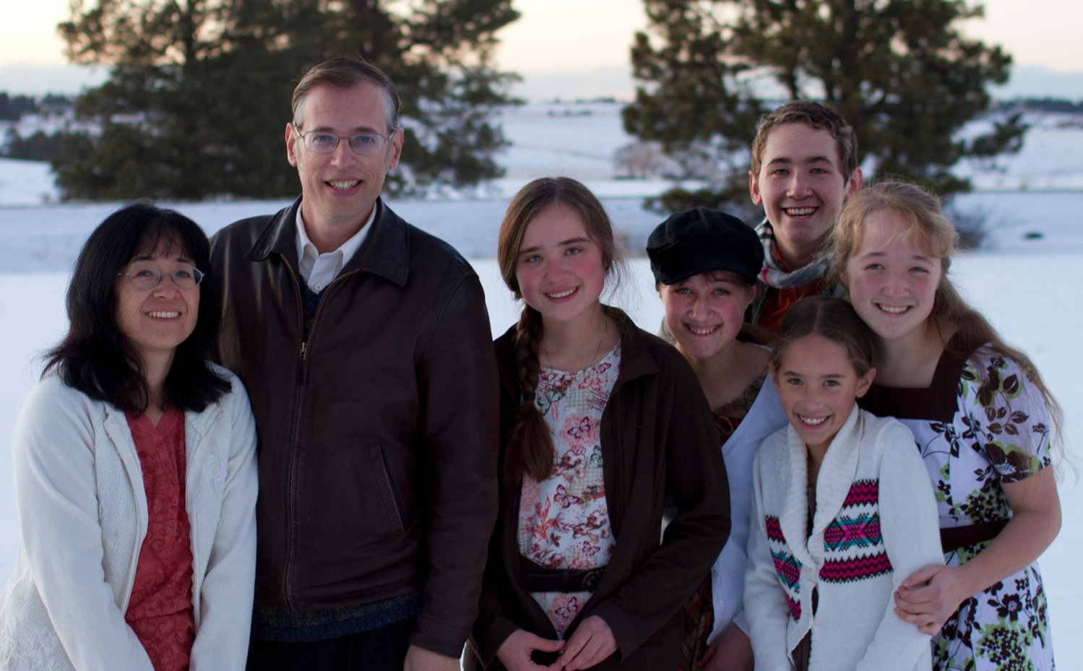
The Book Apostate
Kevin Swanson and his family
Notes:
Kevin Swanson is one heroic writer exposing apostates.

Slide 6
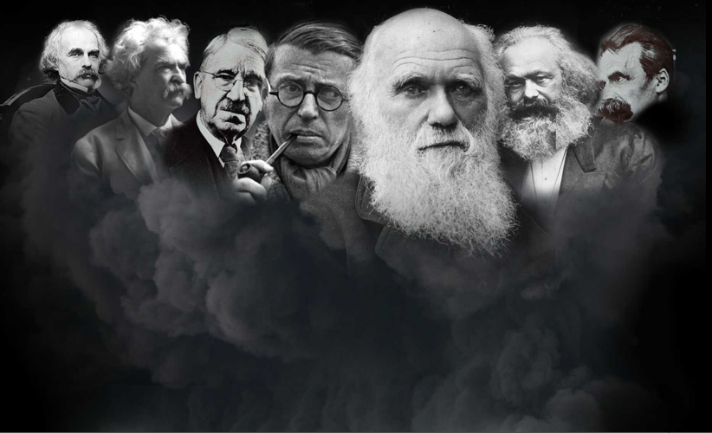
Who are the apostates?
Charles Darwin
Nathaniel Hawthorne
John Dewey
Friedrich Nietzsche
Mark Twain
Karl Marx
Jean-Paul Sartre
Ernest Hemingway
Lady Gaga
Notes:
Who exactly are we talking about? Men like
• Nathaniel Hawthorne,
• Mark Twain,
• John Dewey,
• Jean-Paul Sartre,
• Charles Darwin,
• Karl Marx,
• Friedrich Nietzsche,
• Ernest Hemingway, and
• Lady Gaga.

Slide 7

Why are they significant?
"This is the story of the decline and fall of Western civilization. It is the story of uncommonly powerful men, unfathomably evil men. . . apostates."
–Kevin Swanson

Slide 8
What did the apostates teach?
Charles Darwin
Nathaniel Hawthorne
John Dewey
Friedrich Nietzsche
Mark Twain
Karl Marx
Jean-Paul Sartre
"Eliminate home schools!"
"There is no God!"
"God didn't create. We evolved!"
Notes:
How did they destroy the Christian West?
• Dewey successfully established a public education system in the USA with the purpose of taking children away from the godly influence of their parents.
• Darwin successfully convinced the scientific and academic communities to abandon creationism for evolution.
• Marx successfully convinced generations within many countries that God doesn’t exist, leading to the death of millions.

Slide 9

Godless Philosophy
"God is dead."
– Nietzsche, 1883
"Nietzsche is dead."
– God, 1900
Used with permission
Notes:
Speaking of death, Nietzsche founded the "God is Dead" movement. God had the last word in his life, though, as 17 years later God founded the "Nietzsche is Dead" movement.

Slide 10
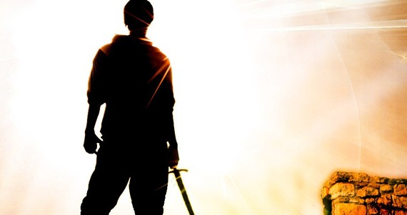
How can you defend the faith against pretenders?
Notes:
We must also fight apostates in our own church!
So how can we fight unbelieving false teachers in our own churches?

Slide 11
Chapters in NT Books
Four "books" of the NT have but 1 chapter
Notes:
Jude told the Christians about AD 75 to fight for the faith.
• Only four NT “books” have but one chapter.

Slide 12
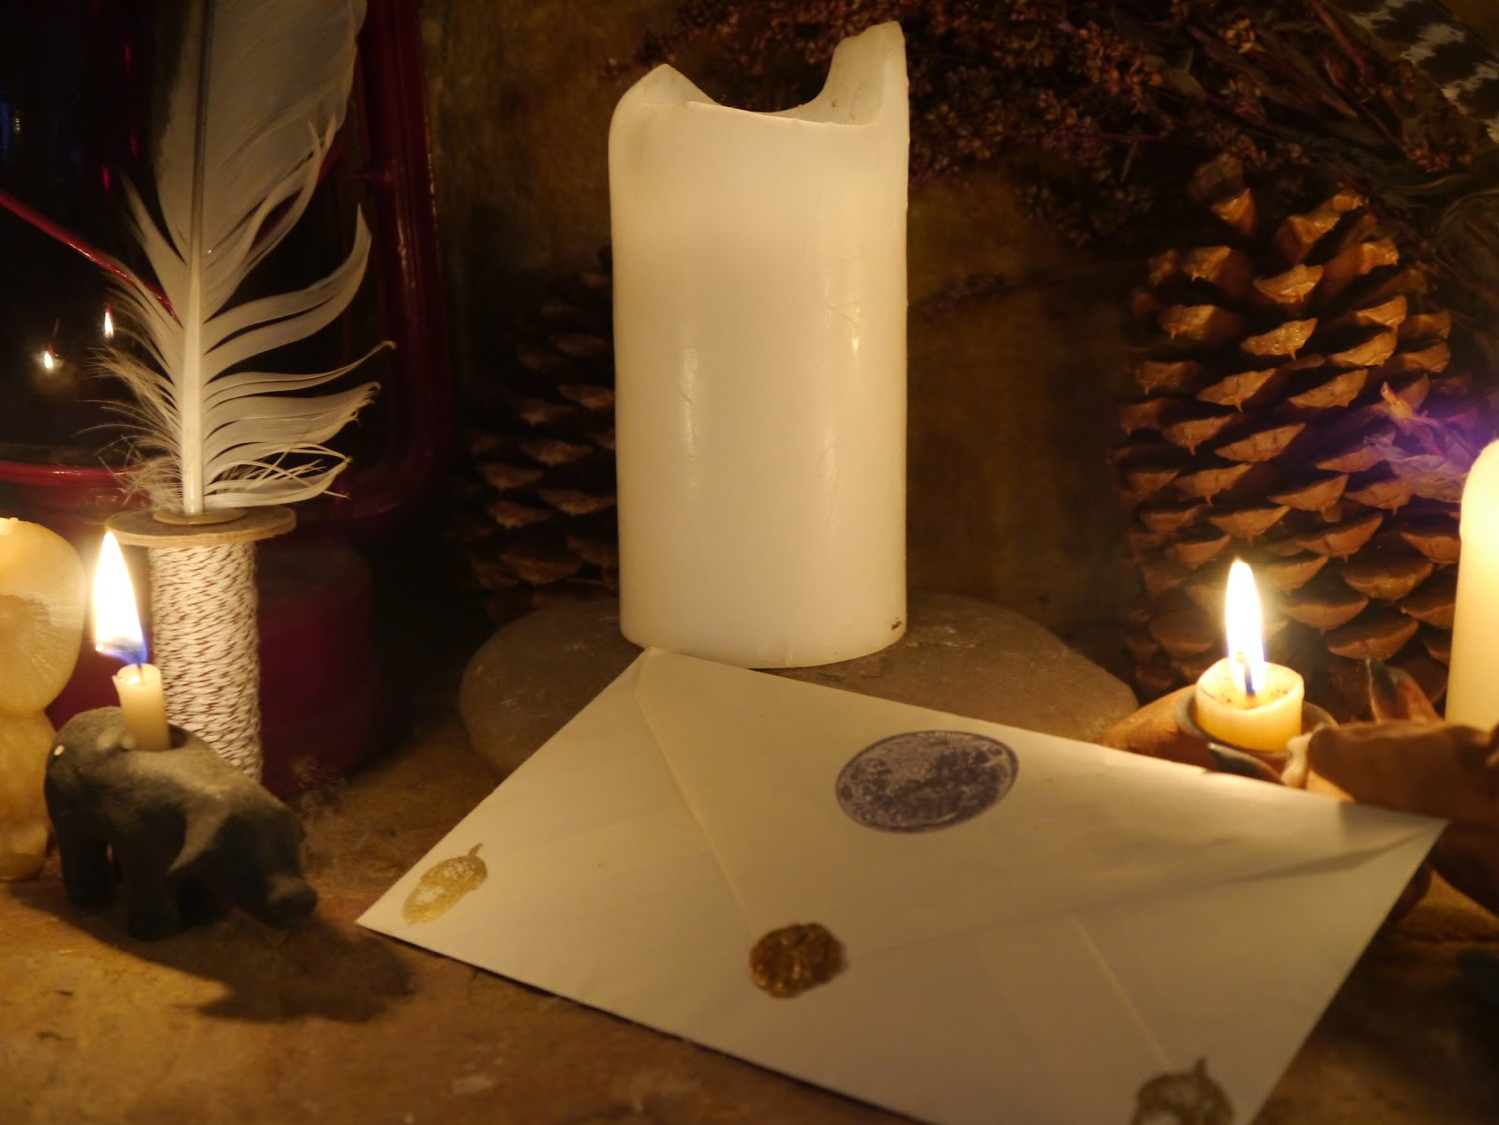
Verses in NT Emails
Notes:
• Though small enough to be considered and email, these short books are incredibly impactful.

Slide 13
NT Overview (General + Key Words)
38
124
39-41
"To the remotest part of the earth" (Acts 1:8)
Acts 9 13 14 15 16 18 21 27 28
Apr 48-
Sep 49
1
Galatia
Apr 50-
Sep 52
2
Aegean
Spr 53-
May 57
3
Asia
Feb 60-
Mar 62
1
Rome
Spr 62-
Fall 67
4
Spain
Aut 67-
Spr 68
2
Rome
Summer 35-
37
Damascus
Antioch
May 57-
Aug 59
Trials
Fall 49
The
Council
Spring 68
Expansion of Church
35 48 49 50 52 53 57 60 62 67 68 95
Matt
Kingdom
Luke
Sov 1
Acts
Sov 2
Mark
Disciple
John
Believe
Gal
Justify
1 Thess
Rapture
1 Cor
Eph
Unity
1 Tim
Order
2 Tim
Sanctify
Doctrine
Jude
Pretenders
James
Works
2 Thess
Tribulation
2 Cor
Col
Deity
Titus
Conduct
Heb
Apostle
Super
Romans
Philem
1 Pet
Righteous
Forgive
Suffering
Gospels & Acts
Phil
Attitude
2 Pet
Knowledge
Pauline Epistles
1234
Journeys
General Epistles
Rome
Imprisonments
General Epistles + Key Words
Notes:
• The letter of Jude was penned late and short.

Slide 14
How can you defend the faith against pretenders?
4 ways
Jude
Notes:
What ways can you fight unbelievers who destroy the church from within?

Slide 15
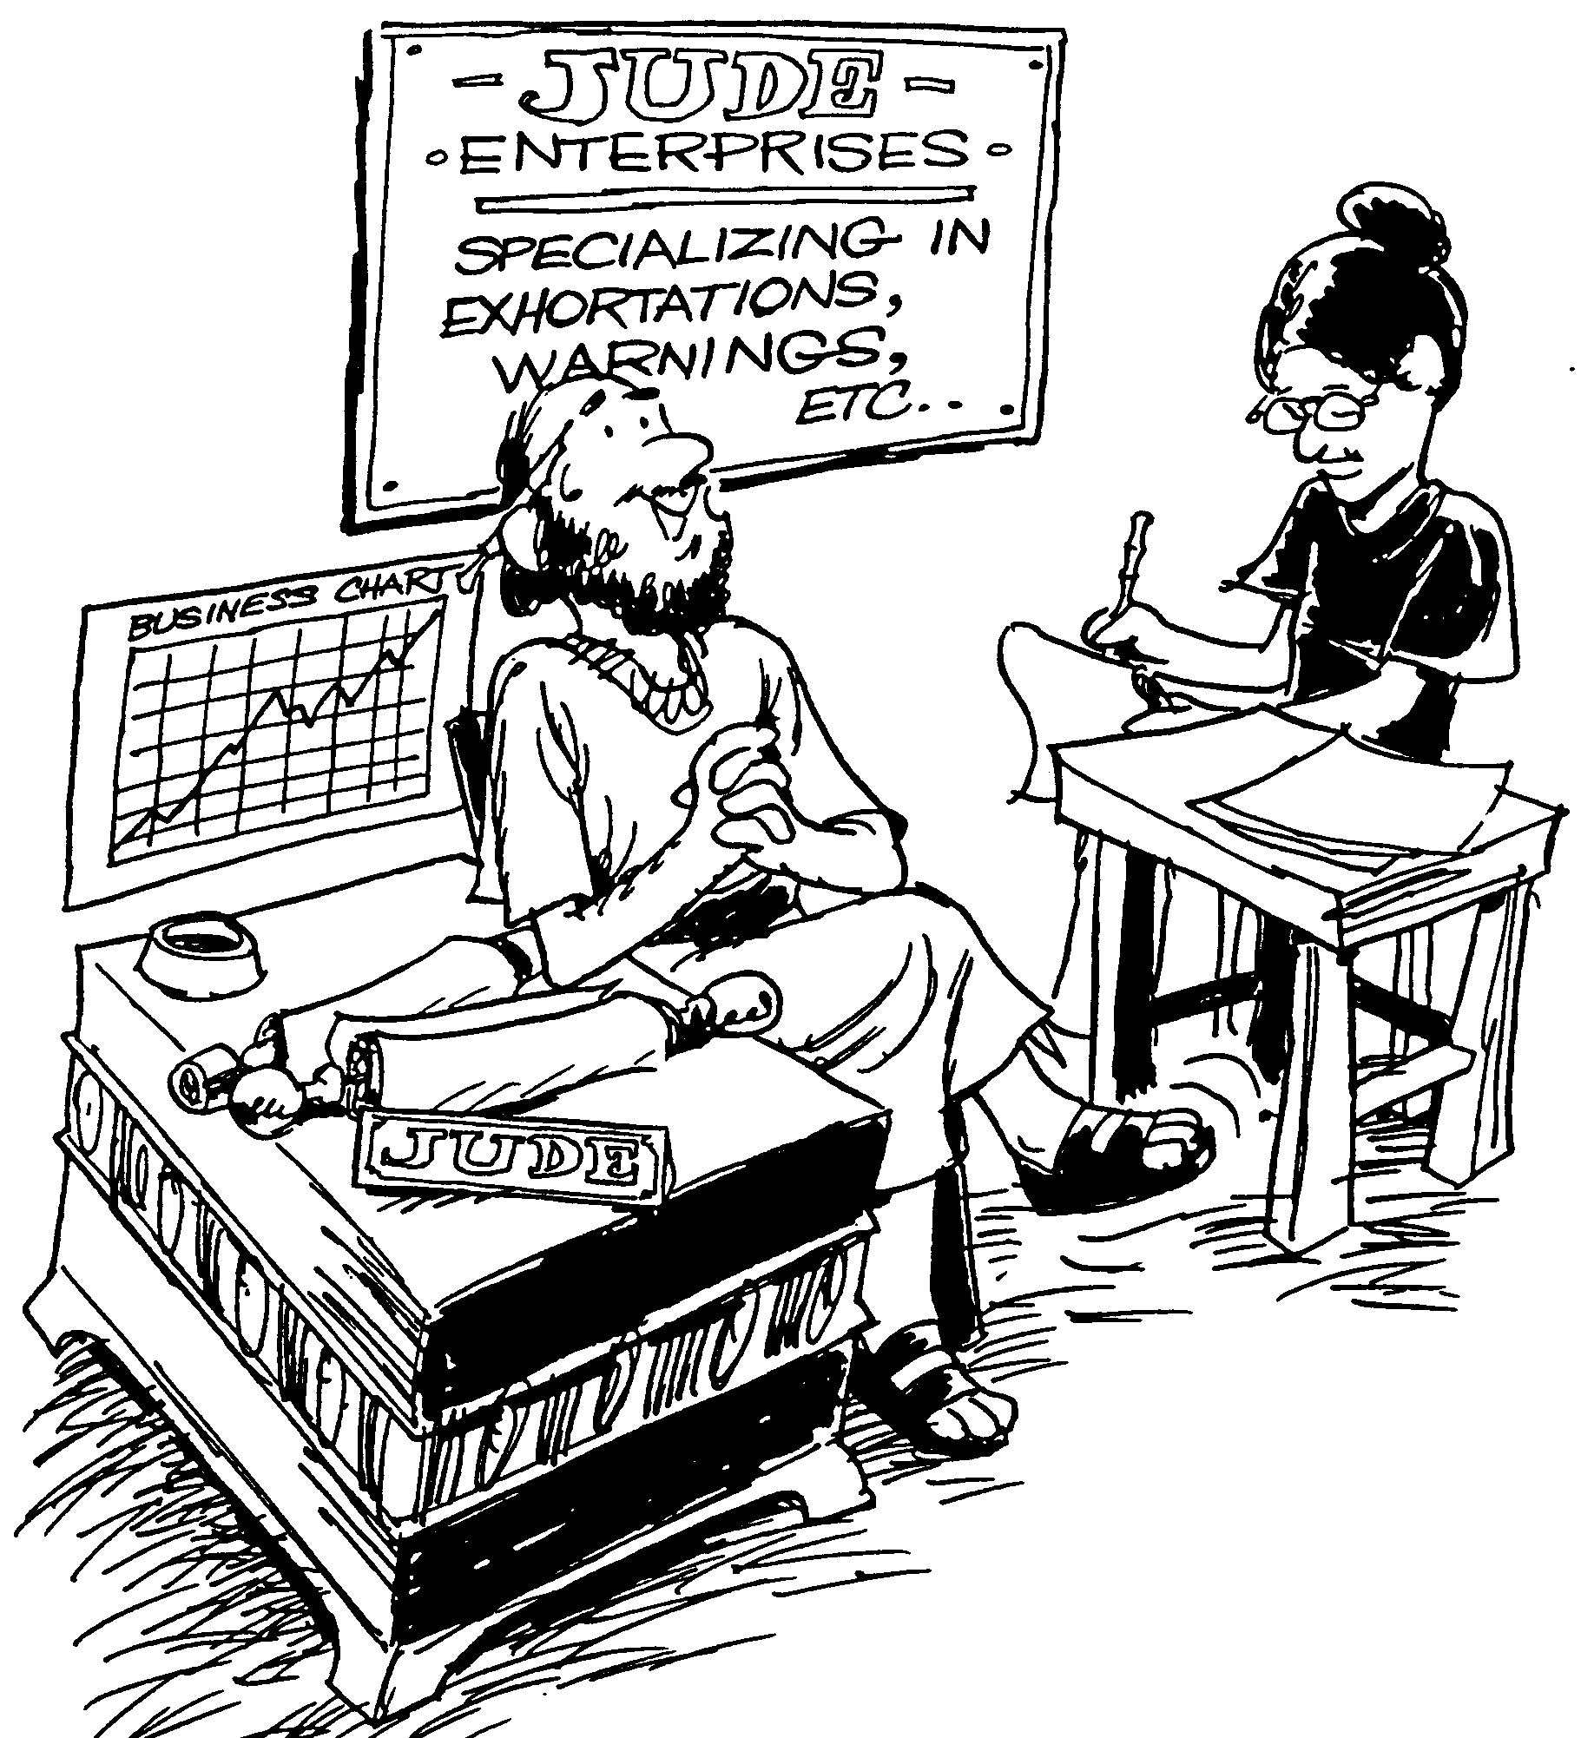
JUDE
Verses
1-4 Jude warns against apostasy
5-7 Unbelief seen through history
8-19 Description of false teachers
20-25 Exhortation to stay faithful
Huddleston, The Acrostic Bible
Notes:
The “email” of Jude is our fighting manual!

Slide 16
Jude – Summary Chart
310
Contending Against Pretenders
Contend Against Pretenders
Why to Contend
Why to Contend
How to Contend
How to Contend
Intro
Intro
Pretenders'
Practices
Pretenders'
Practices
How to Avoid
Pretenders' Snares
How to Avoid
Pretenders' Snares
Praise for Preservation
Praise for Preservation
Verses 1-2
Verses 1-2
Verses 3-16
Verses
3-16
Verses 17-23
Verses
17-23
Verses 24-25
Verses 24-25
Greet-ing
1
Nurture Self in God's Love
20-21
Greet-ing
1
Bless-ing
2
Bless-ing
2
Purpose: Defend the faith
3-4
Purpose of Epistle: Defend the faith
3-4
OT Pretenders
5-7
(Past)
OT Pretenders
5-7
(Past)
Charac-teristics
8-13
(Present)
Charac-teristics
8-13
(Present)
Judgment
14-16
(Future)
Judgment
14-16
(Future)
Remember Apostles' Predictions
17-19
Remember Apostles' Predictions
17-19
Show Mercy to Pretenders' Followers
22-23
Show Mercy to Pretenders' Followers
22-23
Source of
Victory
24
Source of Victory
24
Only Savior
25
Only Savior
25
Unknown Origin to Probably Palestine
Unknown Origin to Probably Palestine
c. AD 75
c. AD 75
Notes:
The letter is about “contending against pretenders.”

Slide 17
Key Word / Verse
310
Key Word
Pretenders
Key Verse
"…Contend for the faith that was once for all entrusted to the saints. For certain men whose condemnation was written about long ago have secretly slipped in among you. They are godless men, who change the grace of our God into a license for immorality and deny Jesus Christ our only Sovereign and Lord" (Jude 3b-4).
Notes:
Its key verse tells us to contend for (or defend) the faith.

Slide 18
Authorship
311
External Evidence
Despite its small size and limited subject matter, Jude was accepted as authentic and quoted by the early Church Fathers, including Tertullian and Origen.
It was also included in the Muratorian Canon
(ca. AD 170).
Internal Evidence
This is the only NT letter of Jude, the half-brother of Jesus Christ & son of Joseph and Mary.
Jude was therefore the brother of James (v. 1a), who also was a half brother of the Lord (Matt. 13:55; Mark 6:3), the leader of the church at Jerusalem (Acts 15:13) and author of the epistle bearing his name (James 1:1).
Jude is the same as Judah or Judas and means "praise"
(cf. Rom. 2:29).
Notes:
The early church had no problem accepting this letter, despite its short size.

Slide 19
The Family of Jesus
Holy
Spirit
Men in white
Mary
Joseph
Women in yellow
Jesus
Joseph
Simon
Sister 2
James
Judas
Sister 1
"Then they scoffed, 'He's just a carpenter, the son of Mary and the brother of James, Joseph, Judas, and Simon. And his sisters live right here among us.' They were deeply offended and refused to believe in him" (Mark 6:3 NLT).
Notes:
The letter itself shows evidence of being written by the half brother of Jesus. Judas was also called Jude.

Slide 20
How can you defend the faith against pretenders?
4 ways
Jude
Notes:
What ways can you fight unbelievers who destroy the church from within?
(The first way you can defend the faith against pretenders is to...)

Slide 21
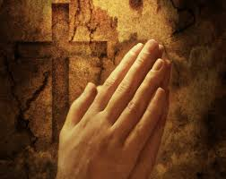
I. Affirm the saints (1-2).
Jude
Notes:
Tell believers about their riches in Christ.

Slide 22
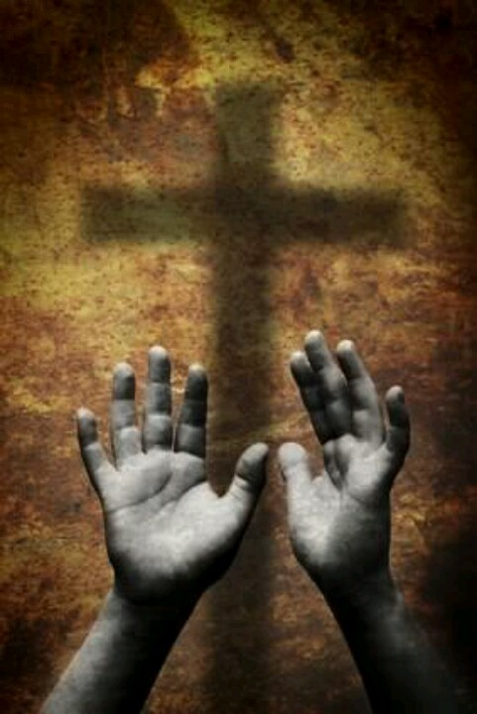
"This letter is from Jude, a slave of Jesus Christ and a brother of James. I am writing to all who have been called by God the Father, who loves you and keeps you safe in the care of Jesus Christ. ²May God give you more and more mercy, peace, and love" (Jude 1-2 NLT).
Notes:
God himself calls us to salvation (1a).
God himself loves us (1b).
God himself keeps us in his forever family (1c).
God himself gives us mercy, peace, and love (2).
Mercy is the first grace to be multiplied as God's protection from merciless pretenders (2a).
Peace is wished upon the readers in the midst of their war against false teachers (2b).
Love from God is wished upon the readers as protection and assurance in their trials (2c).

Slide 23
How can you defend the faith against pretenders?

Slide 24
I. Affirm the saints (1-2).
Jude
Notes:
Tell believers about their riches in Christ.
Our first defense against nominal Christians is to affirm the true believers of their high position in Christ. But shouldn’t we also make sure we know who we’re talking about? Yes! Verses 3-16 tell us to…

Slide 25
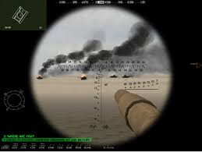

II. Identify the enemy (3-16).
Jude
Notes:
Know the evil nature of the apostates who pretend to know God.

Slide 26
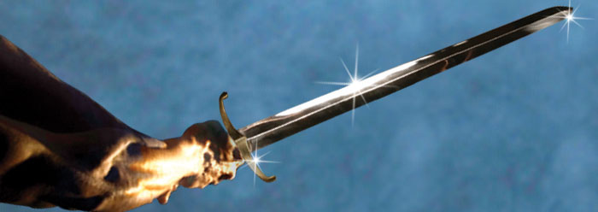
"Dear friends, I had been eagerly planning to write to you about the salvation we all share. But now I find that I must write about something else, urging you to defend the faith that God has entrusted once for all time to his holy people" (Jude 3 NLT).
Notes:
Defend the faith against pretenders who infiltrate the church (3-4).
His original purpose was to write on the salvation he shared with his readers (3a).
After learning that his readers faced apostates among them, and through the Spirit's leading, Jude changed his theme to defend doctrinal truth (3b).

Slide 27
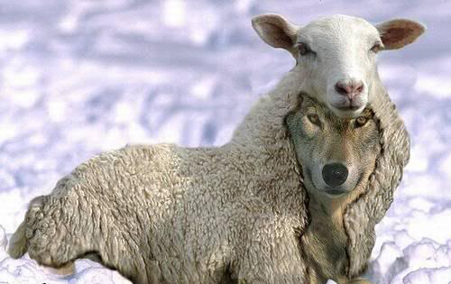
Who are Pretenders Today?
"…ungodly people have wormed their way into your churches, saying that God's marvelous grace allows us to live immoral lives. The condemnation of such people was recorded long ago, for they have denied our only Master and Lord, Jesus Christ"
(Jude 4 NLT).
Notes:
Jude changed his original purpose to write because prophesied (e.g., Isa. 8:19-22; cf. Jer. 5:12-14) unbelieving pretenders infiltrated the church (4).

Slide 28
Are pretenders Christians?
"…some ungodly people have wormed their way into your churches, saying that God's marvelous grace allows us to live immoral lives. The condemnation of such people was recorded long ago, for they have denied our only Master and Lord, Jesus Christ" (Jude 4 NLT).
No, as they are condemned, unlike believers (cf. Rom 8:1)
They are like demons in everlasting chains (v. 6)
They are like Sodomites who suffer eternal fire (v. 7)
They are reserved for "blackest darkness" (v. 13)
They "do not have the Spirit" (v. 18) while all believers do have the Spirit (Rom 8:9b)
Does that sound like Christians?
Notes:
Are pretenders Christians? No. Pretenders are not true believers.

Slide 29
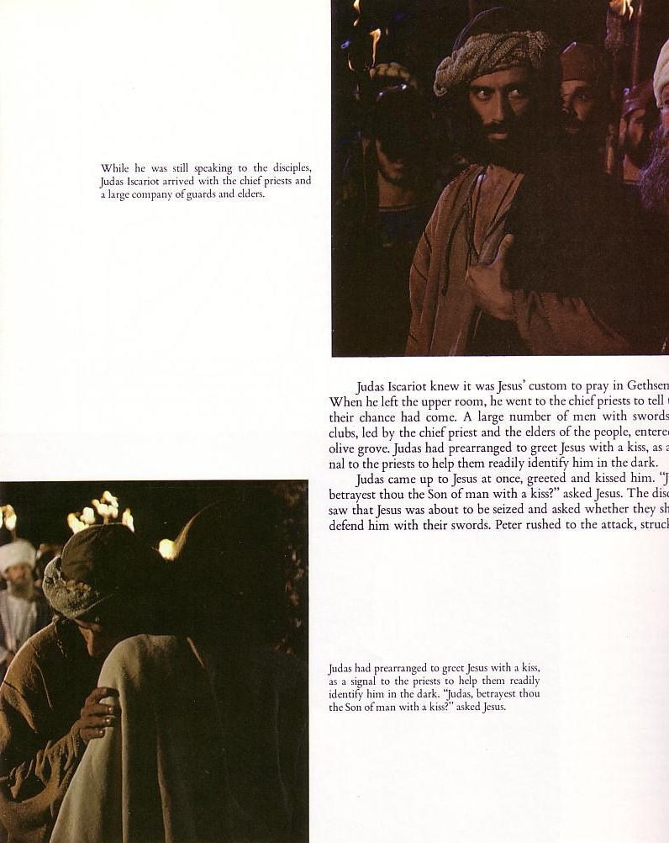
Judas: The Ultimate Pretender
Notes:
Judas was the ultimate pretender. Imagine: He was there with Jesus himself for three years but never really trusted Christ! He ate with him, heard all the teaching, even went out in evangelism paired up with another disciple—but still never knew Christ! He betrayed him with a kiss.

Slide 30
The “Professing Christian”
All of Humanity
Professors
Non-Christians
Christians
Notes:
In this regard, I’d like to clarify the identity of what we call the “Professing Christian.”
• All Humanity: Suppose this circle represents all people.
• Christians: A portion of all humanity is the true Christian community that genuinely knows Christ personally. The rest are non-Christians.
But where do we put “professing Christians”? Inside the white or the black circle?
• Since a “professing Christian” doesn’t really know Christ, is he a type of Christian? No! He only professes to be a Christian, but in reality is a type of non-Christian. He is a pretender.

Slide 31
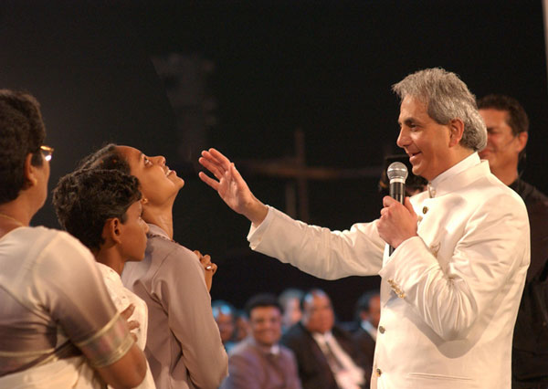
Pretenders Today
"He promises to heal all – every one, any, any whatsoever, everything – all our diseases! That means not even a headache, sinus problem, not even a toothache – nothing! No sickness should come your way. God heals all your diseases."
Benny Hinn
Rise and Be Healed, 32
http://deliveredbygrace.com/?p=234
Notes:
As an example, Benny Hinn teaches that we are “God” who gets God to heal every disease! I hear that he has actually renounced his teaching and truly come to know Christ. I hope that is true!
_____
One writer notes,
"As a proponent of the Word of Faith movement, the Benny Hinn Ministry works within the bounds of the "Prosperity Gospel" asking for money and telling people to expect a miracle in return. With large crusades, Benny Hinn travels the world doing what he refers to as the "Lord's work." The crusades involve prayer and Scripture reading, but the grand stage and central focus of each crusade is the miracle healing portion of each crusade. According to Benny Hinn, the miracles that are performed have medical documentation and evidence to back up the miracles. However, when people start searching for such documentation, it is nowhere to be found. One such person who has done extensive research is Justin Peters. Justin is an evangelist who is crippled by a well known disease called Cerebral Palsy. While doing his Master's Thesis research at Southwestern Baptist Theological Seminary, Peters sought out to interview Benny Hinn, but his requests were denied. Justin also tried to make it to the stage during a miracle crusade of Benny Hinn, but since he was obviously crippled, he was denied the opportunity to go onto the stage with the miracle healer. Justin, like many others, were stopped by members of the Benny Hinn staff who screen people before they go onto the stage" ("Benny Hinn Exposed," posted by Josh Buice on Mar 26, 2008 at http://deliveredbygrace.com/?p=234).

Slide 32
Three OT Examples of Pretenders (Jude 5-7)
Notes:
Be aware of three OT pretenders so you can avoid them (5-7).

Slide 33
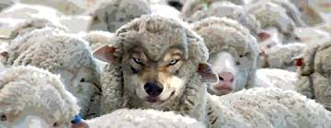
"So I want to remind you, though you already know these things, that Jesus first rescued the nation of Israel from Egypt, but later he destroyed those who did not remain faithful" (Jude 5 NLT).
Notes:
Of the two million Israelites delivered from Egypt, some did not believe God like the pretenders of whom Jude warns (5; cf. Korah, v. 11 in Num. 16).

Slide 34
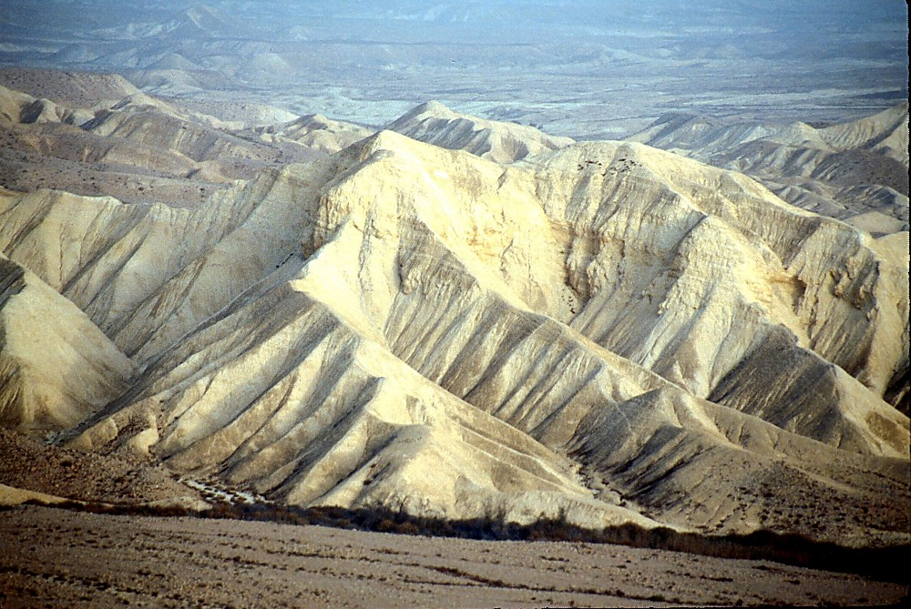
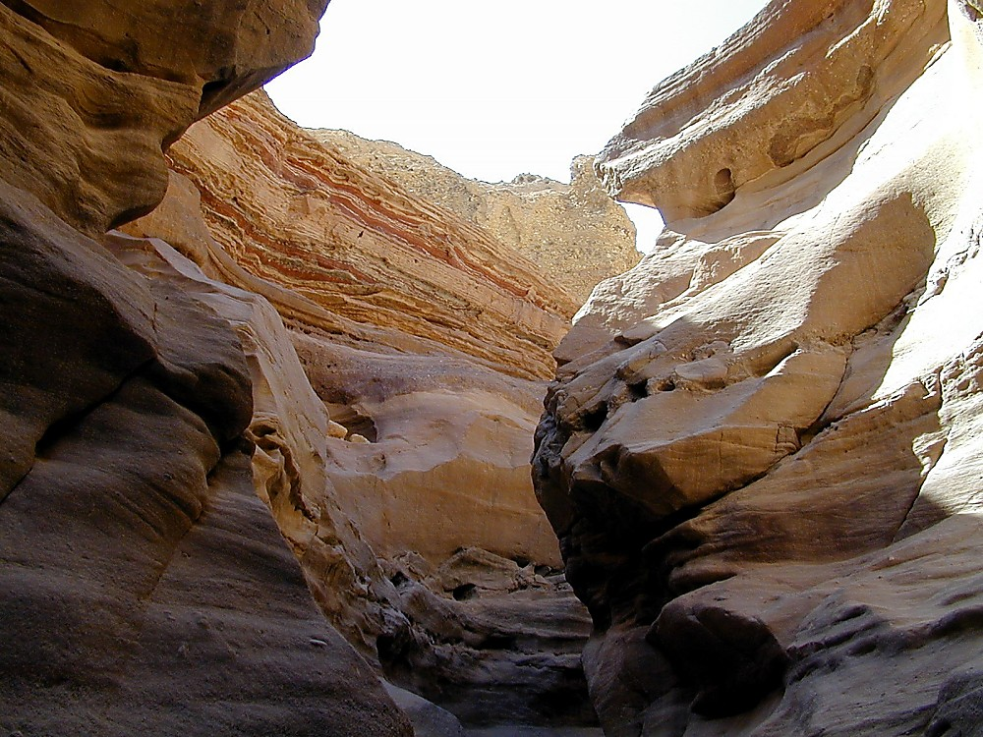
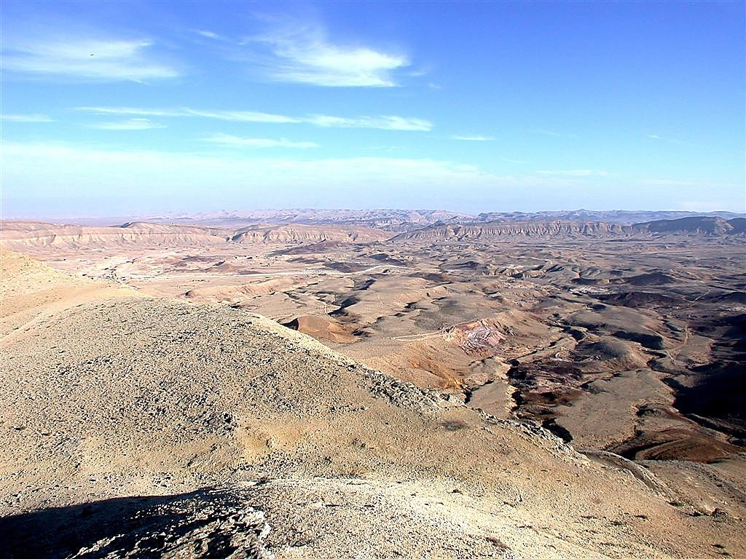
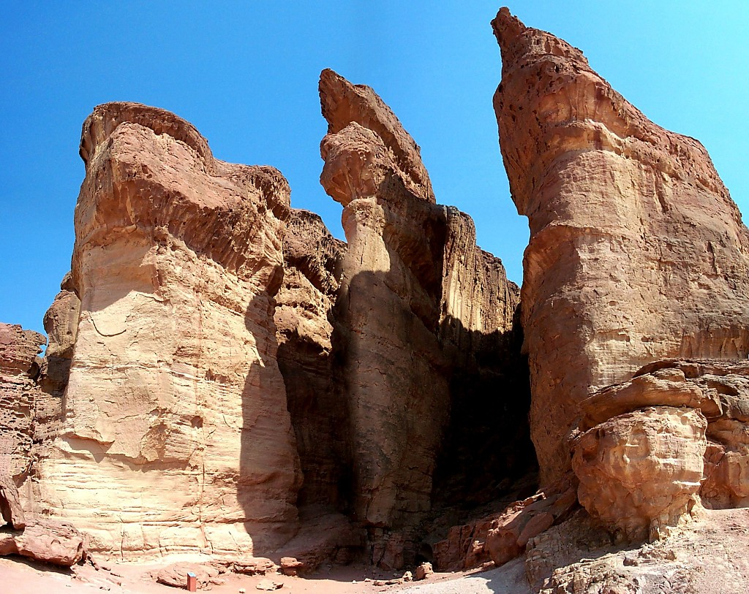
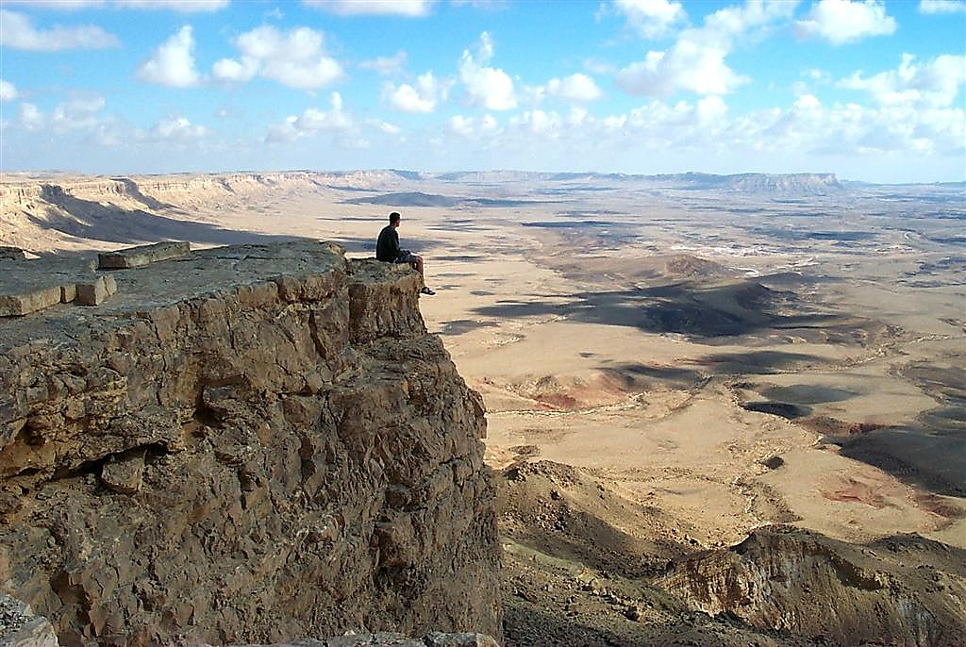
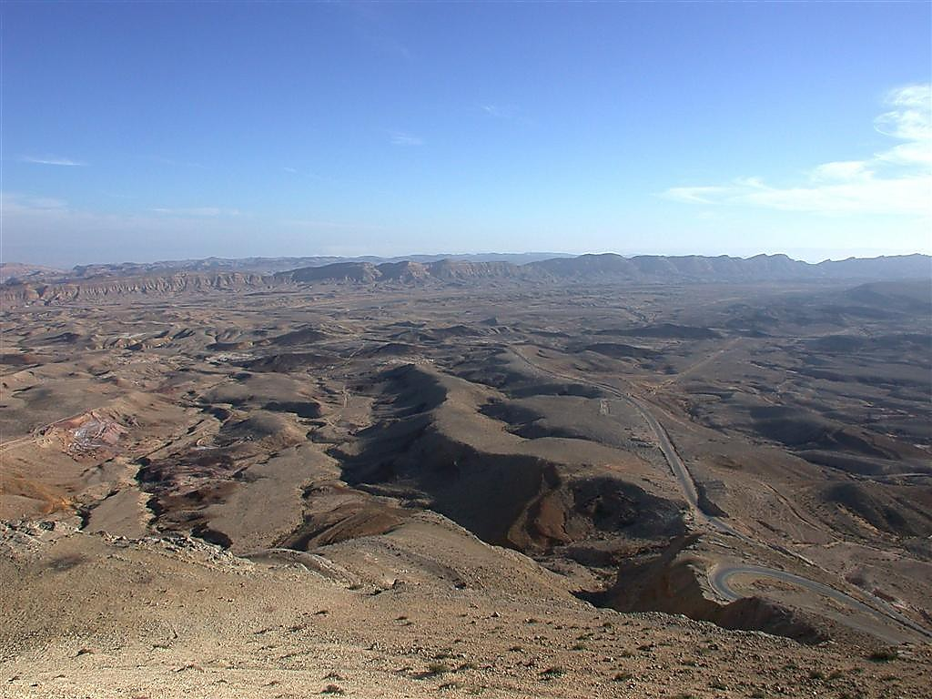
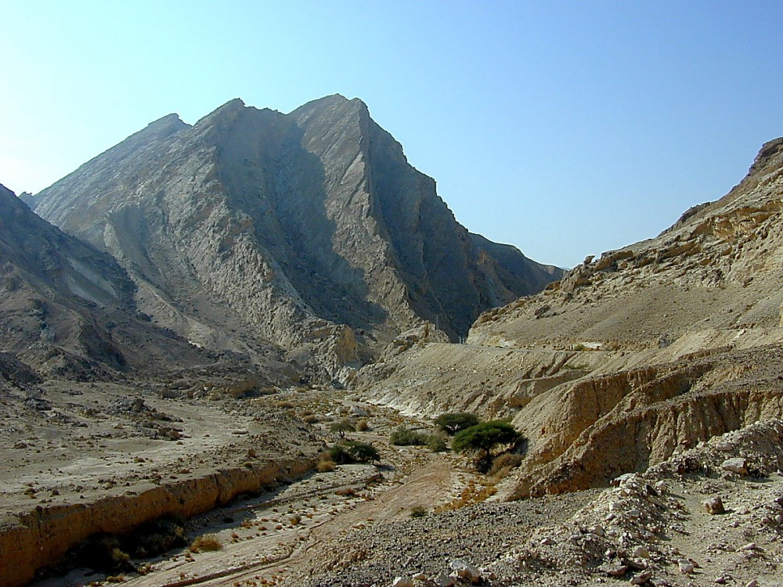
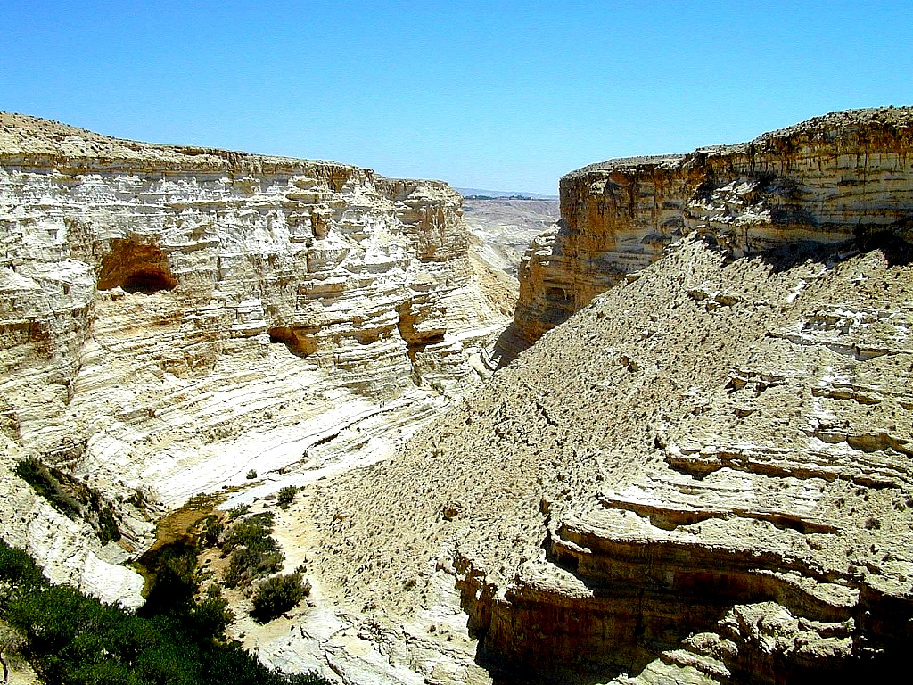
Divine Discipline
Num. 32:49; 34:1
DRESSING
THE
STAGE
YOU MEAN…
40 YEARS? OUT HERE?
MOSES
Exodus
Sinai
M - C - C
Kadesh Barnea
40
40
Handbook pg. 26-29
24

Slide 35
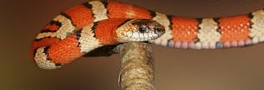
"So the Lord sent poisonous snakes among the people, and many were bitten and died. ⁷Then the people came to Moses and cried out, 'We have sinned by speaking against the Lord and against you. Pray that the Lord will take away the snakes.' So Moses prayed for the people" (Numbers 21:6-7 NLT).
Notes:
God disciplined the people with snakes for speaking against him (Num 21:6-7).

Slide 36
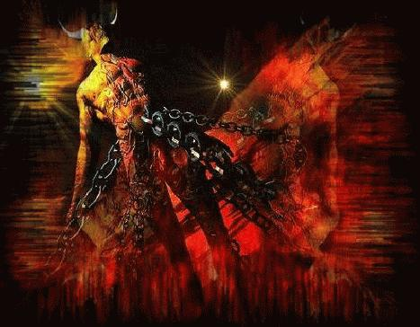
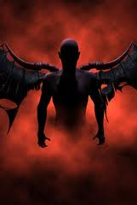
The Angels
Issues in Jude
"And I remind you of the angels who did not stay within the limits of authority God gave them but left the place where they belonged. God has kept them securely chained in prisons of darkness, waiting for the great day of judgment" (Jude 6 NLT).
Notes:
• Some demons that possessed rulers who seduced women [Gen. 6:1-4] are now punished and awaiting judgment to illustrate the pretenders' end in hell (6).

Slide 37
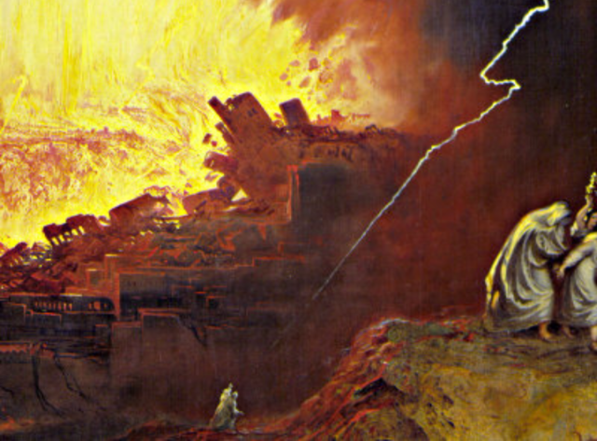
"And don't forget Sodom and Gomorrah and their neighboring towns, which were filled with immorality and every kind of sexual perversion.
Those cities were destroyed by fire and serve as a warning of the eternal fire of God's judgment” (Jude 7 NLT).
Notes:
Sodom, Gomorrah, and nearby towns, who were judged for homosexuality, show that pretenders will suffer eternal fire (7).

Slide 38
The Behavior of Pretenders (Jude 8-13)
Notes:
Note the godless behavior of pretenders to avoid them and their practices (8-13).

Slide 39

"In the same way, these people—who claim authority from their dreams—live immoral lives, defy authority, and scoff at supernatural beings" (Jude 8 NLT).
Notes:
Their speech rejects all authorities, including angelic ones, unlike Michael's refusal to dispute with Satan over Moses' body (8-10).
They pollute their bodies and reject authorities, even speaking against angelic authorities (8).

Slide 40
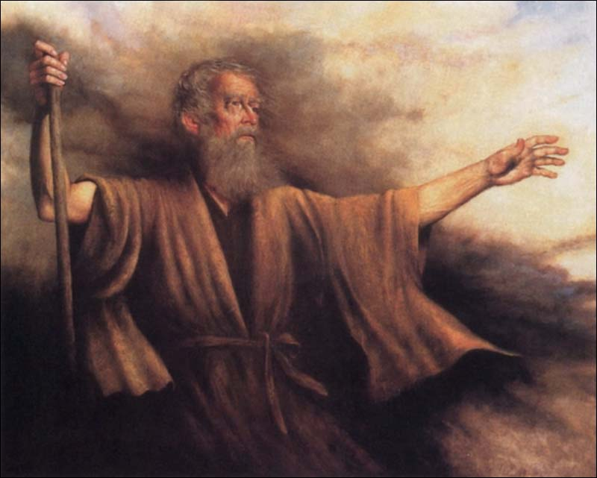
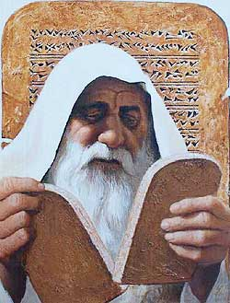
Moses' Body
Issues in Jude
"But even Michael, one of the mightiest of the angels, did not dare accuse the devil of blasphemy, but simply said, "The Lord rebuke you!" (This took place when Michael was arguing with the devil about Moses' body.)" (Jude 9 NLT).
Notes:
These men should never slander angels since Michael didn’t argue with Satan over where to bury Moses' body but left the matter in God's hands [9b, as recorded in the Pseudepigrapha book, The Assumption of Moses].

Slide 41


Joel Osteen, Pastor of Lakewood Church
Notes:
In a similar way, Joel Osteen blasphemes God by applying the divine title “I Am” to himself!

Slide 42
"But these people scoff at things they do not understand. Like unthinking animals, they do whatever their instincts tell them, and so they bring about their own destruction. ¹¹What sorrow awaits them! For they follow in the footsteps of Cain, who killed his brother. Like Balaam, they deceive people for money. And like Korah, they perish in their rebellion" (Jude 10-11 NLT).
Notes:
The pretenders slander angels whom they don't understand and, like unreasoning animals, fall into destruction by practices whose effects they know full well (10).
Their religion will kill others as Cain killed his brother Abel [Gen. 4:8] (11a).

Slide 43

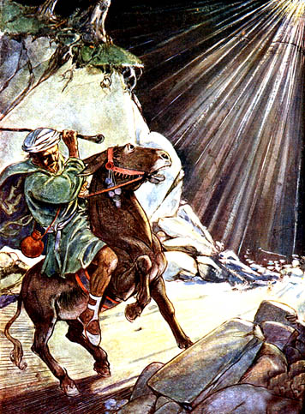
Balaam
Balaam Numbers 22–24
Notes:
Their greed resembles Balaam’s claim to speak for God, but actual motive for money [Num. 22] (11b).

Slide 44
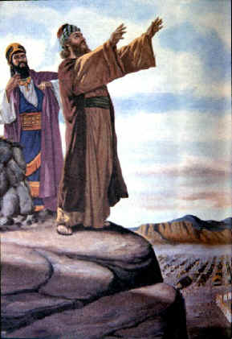
The Balaam Narrative
140
Balak fails to turn God against Israel–blessing by Balaam (Num. 22–24)
Beitzel, Moody Atlas, 1st ed., 94
Notes:
Balaam looked like he honored God (Num 22–24).

Slide 45
2 Peter 2:15-16 (NIV)
"They have left the straight way and wandered off to follow the way of Balaam son of Beor, who loved the wages of wickedness. But he was rebuked for his wrongdoing by a donkey–a beast without speech–who spoke with a man's voice and restrained the prophet's madness."

Slide 46
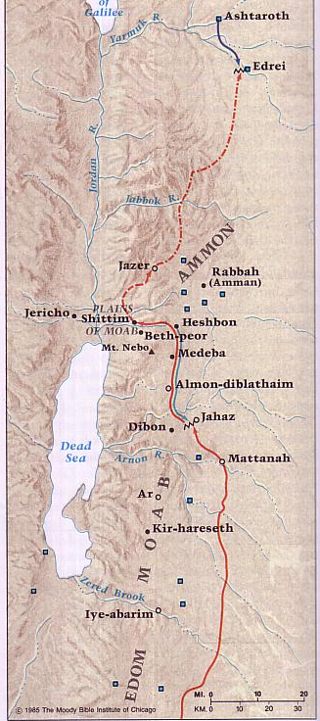
Transjordan Events
140
Victory over Sihon and Og (Num. 21)
Balak fails to turn God against Israel–blessing by Balaam (Num. 22–24)
Balak succeeds to turn Israel against God–immorality at Beth-peor (Num. 25)
Beitzel, Moody Atlas, 1st ed., 94
Notes:
However, he got the people off into immorality.

Slide 47
Jude 11 (NIV)
"Woe to them! They have taken the way of Cain; they have rushed for profit into Balaam's error; they have been destroyed in Korah's rebellion."
Notes:
Balaam made a lot of money getting the Israelites involved in sexual sin—just as many do today!

Slide 48
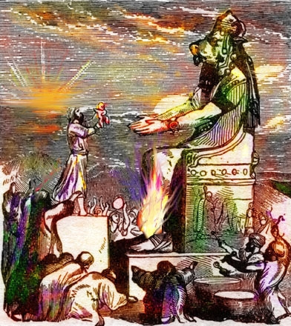

The Balaam Narrative (Num. 22–24)
140
Balak turned Israel against God via immorality at Bethpeor (Num. 25)
Beitzel, Moody Atlas, 1st ed., 94

Slide 49
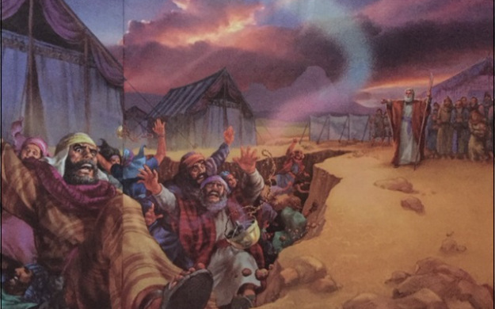
Korah's Rebellion
Korah, Dathan and Abiram (Numbers 16:31-34)
Notes:
Apostate rebellion is against leaders whom God designated like the rebellion Korah led against Moses so they will also suffer death [Num. 16] (11c).
Korah rebelled against Moses and the earth swallowed his family.

Slide 50
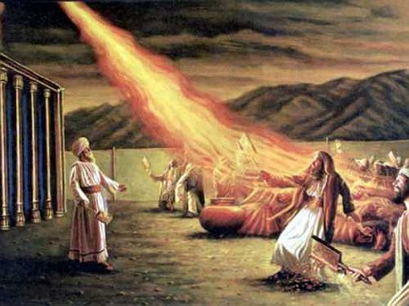
More Complaining
"Then fire blazed forth from the LORD and burned up the 250 men who were offering incense"
(Num 16:35 NLT).
Notes:
Similarly, the leaders with him were burned (Num 16:31-35).

Slide 51
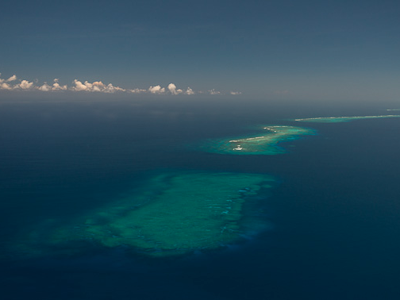
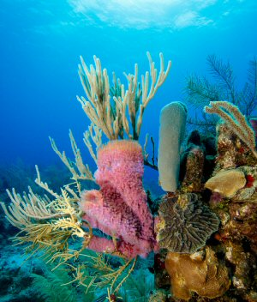
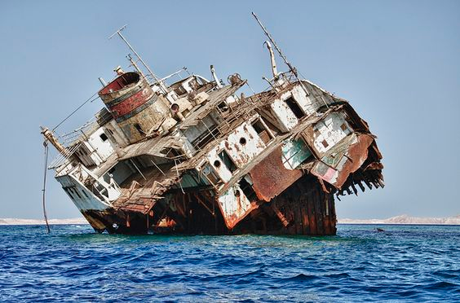
"When these people eat with you in your fellowship meals commemorating the Lord's love, they are like dangerous reefs that can shipwreck you"
(Jude 12a NLT).
Notes:
Nature graphically illustrates the destructive lifestyles of the pretenders to warn us to avoid their practices (12-13).
• Like hidden reefs that wreck ships before they are detected, pretenders even join in the most intimate church celebrations while they destroy it within (12a).
• Reefs are beautiful for diving, but not for ships!

Slide 52
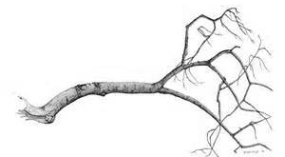
"They are like shameless shepherds who care only for themselves. They are like clouds blowing over the land without giving any rain. They are like trees in autumn that are doubly dead, for they bear no fruit and have been pulled up by the roots" (Jude 12b NLT).
Notes:
Like shepherds who feed themselves rather than the sheep, these leaders seek only their own desires (12b).
Like clouds seemingly filled but waterless and blown around, these men appear saintly but have no teaching for thirsty souls (12c). Why? They don’t understand even major doctrines and are easy seduced by the latest theological trends.
Like trees lacking the expected autumn fruit, they lack Christian character but are dead in their sins and will experience eternal separation from God (12d).

Slide 53

PASTORS
Psalm 1:1-3
1 Peter 1:3-9
2 Corinthians 1:3-7
Notes:
In this vein, what about the prosperity gospel? Well, God prospers us—along with suffering!

Slide 54
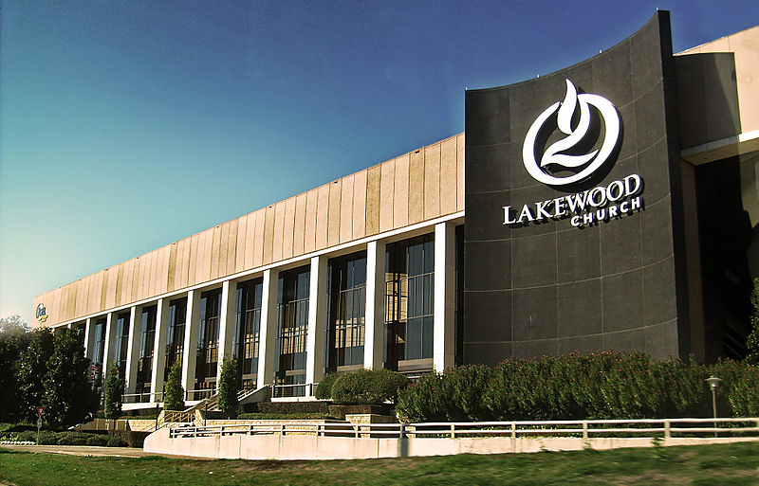
Lakewood Church, Houston, TX, USA
Notes:
Not according to Lakewood Church!

Slide 55
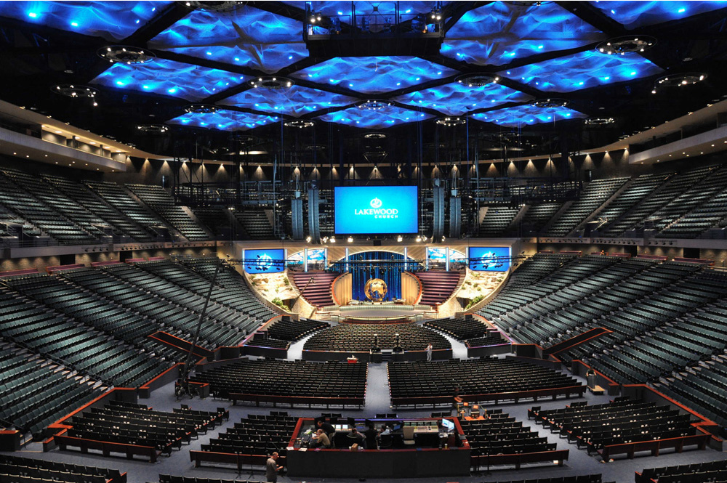
Lakewood Church, Houston, TX, USA
Notes:
This megachurch has a rule that sin can never be addressed from the pulpit.

Slide 56
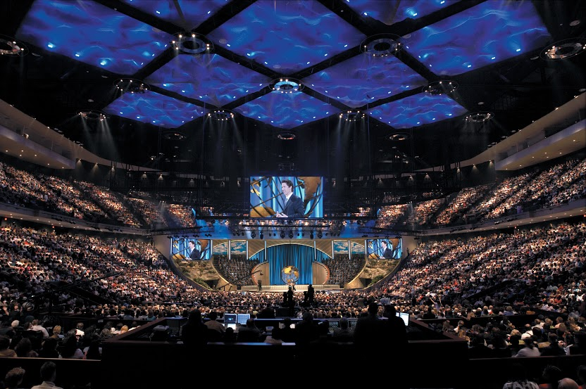
Lakewood fills the 16,800-seat facility
Notes:
Each Sunday 45,000 attend the various services, making Lakewood the largest church ever in the USA.

Slide 57
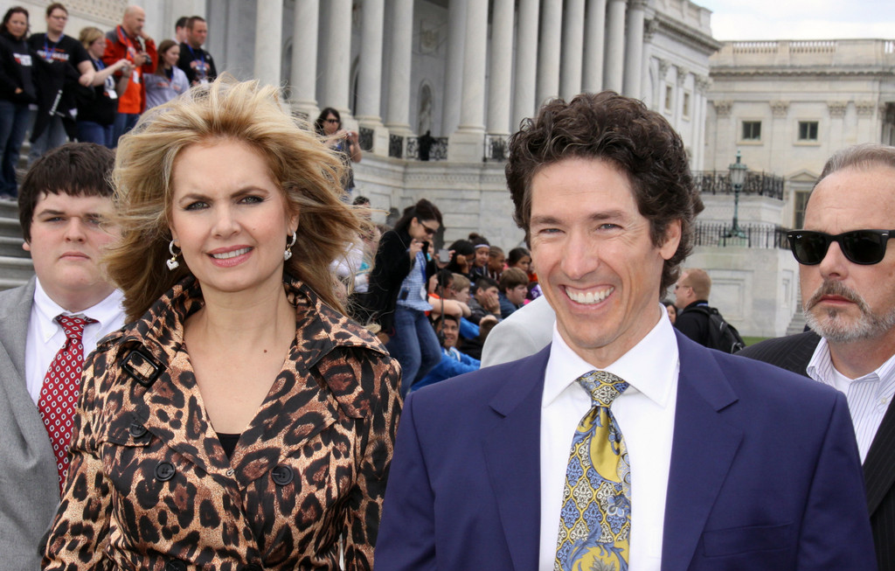
Joel Osteen, Founder of Lakewood Church
Notes:
But former pastor Joel Osteen preaches prosperity only.

Slide 58
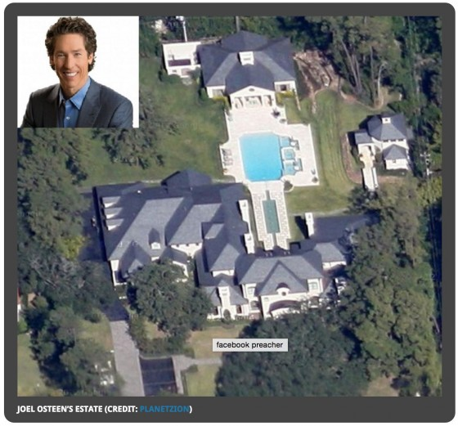
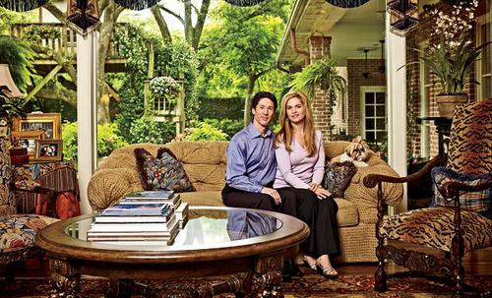
Joel Osteen House
Notes:
He lives prosperity too in a mega home.

Slide 59

Joel Osteen, Former Pastor of Lakewood Church until he reverted to his water purifying business
Notes:
In recent years, he shifted to his $10 million water purifying business.

Slide 60
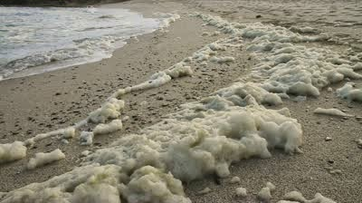
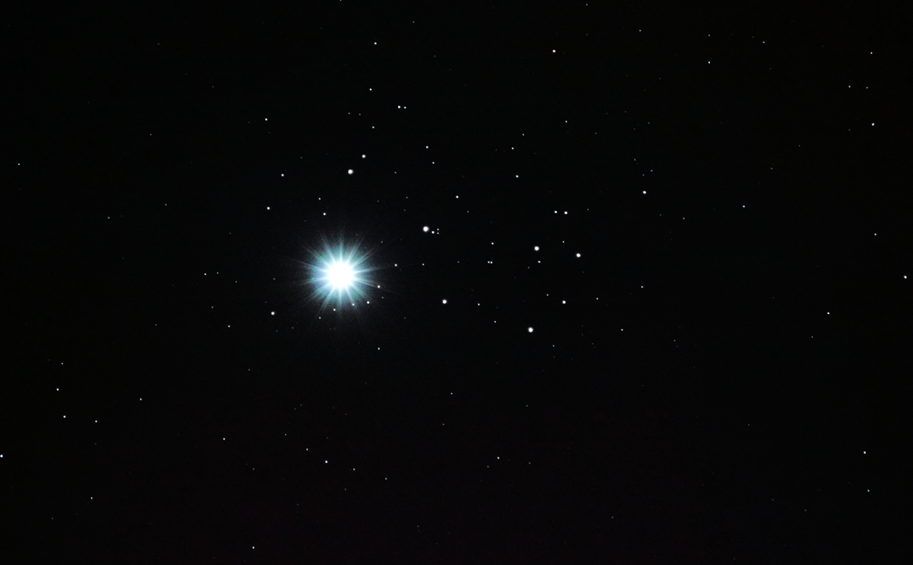
"They are like wild waves of the sea, churning up the foam of their shameful deeds. They are like wandering stars, doomed forever to blackest darkness"
(Jude 13 NLT).
Notes:
Like waves of the sea that direct ships nowhere, these men give no helpful or edifying guidance but instead practice shameful actions (13a).
Like shooting stars moving across the sky and vanishing without light or direction, pretenders lead followers astray from God's truth to hell (13b).

Slide 61
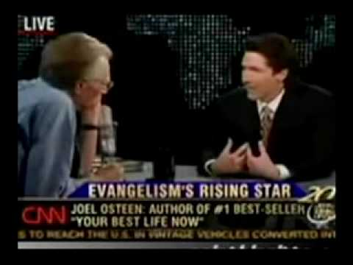
Joel Osteen Interview by Larry King
YouTube Uploaded on Apr 7, 2008
"God alone will judge." "There are many ways to Jesus."
Notes:
Osteen said it himself that “there are many ways to Jesus” through a variety of religions.
_____
https://www.youtube.com/watch?v=KwL1DThtxYg&hl=en-GB&gl=SG

Slide 62
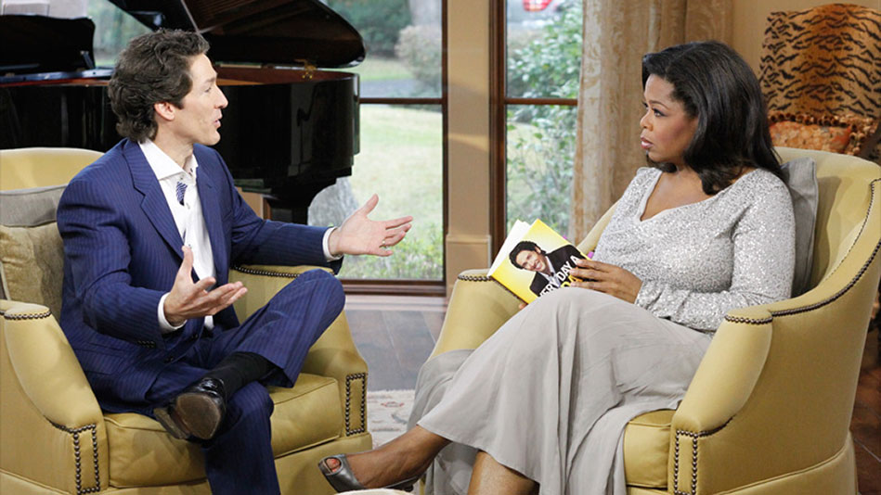
Joel Osteen Interview by Oprah Winfrey
Oprah then moved to her point by asking, "Ok, here's the big question. Are there many paths to get to the one God?" Osteen responded, "Well, I believe Oprah that there, I believe that Jesus is the way to the one God, but there are many paths to Jesus. You know, you don't know how Jesus would reveal himself to somebody."
Notes:
Picture from https://www.youtube.com/watch?v=RTcLqZSuCP8
Text from http://www.deliveredbygrace.com/joel-osteen-does-it-again/

Slide 63
The Destiny of Pretenders (Jude 14-16)
Notes:
Where does it all lead? See the future judgment of pretenders for their selfishness to avoid them (14-16).

Slide 64
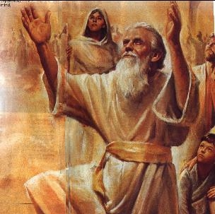
Enoch as a Prophet
Issues in Jude
"Enoch, who lived in the seventh generation after Adam, prophesied about these people"
(Jude 14a NLT).
Notes:
Enoch prophesied the judgment of pretenders at Christ’s Second Coming to warn people to avoid them (14-15).

Slide 65


No Gaps in Genesis 5
Issues in Jude
Adam
State lengths of time
Shorter lengths
Most natural
Show father-son
Jude 14
Seth
Enosh
7
Kenan
Mahalalel
Jared
Enoch
"Enoch, in the seventh generation from Adam, prophesied saying. . ."
(Jude 14a, NASB)
Methuselah
Lamech
Noah
Notes:
Enoch as the seventh generation from Adam reminds us to take the Bible in its normal sense! Genesis 5 has no gaps!

Slide 66
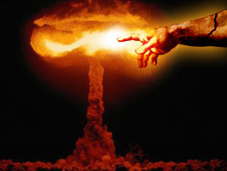
Quoting The Book of Enoch
Issues in Jude
[Enoch] said, "Listen! The Lord is coming with countless thousands of his holy ones ¹⁵to execute judgment on the people of the world. He will convict every person of all the ungodly things they have done and for all the insults that ungodly sinners have spoken against him" (Jude 14b-15 NLT).
Notes:
Enoch, accurately quoted by the Pseudepigrapha Book of Enoch [1:9], prophesied of the pretenders' judgment to guard believers from them (14a).

Slide 67

Why is a Quote from Non-Scriptural Writings a Problem?
Issues in Jude
Jude does not imply that the entire 1 Enoch is inspired.
Notes:
At His Second Coming with saints and angels with Him, Christ will judge these men for their ungodly actions and words spoken against Him (14b-15).

Slide 68

"These people are grumblers and complainers, living only to satisfy their desires. They brag loudly about themselves, and they flatter others to get what they want” (Jude 16 NLT).
Notes:
Their selfish lifestyles show us to recognize and avoid them (16).
They complain about difficulties rather than rejoice in them (16a).
They find fault in others rather than encourage them (16b).
They lust for their own, sensual advantage rather than serve others (16c).
They boast about their own achievements rather than praise others (16d).
They flatter others for special treatment rather than minister to them unselfishly (16e).

Slide 69
How can you defend the faith against pretenders?

Slide 70
I. Affirm the saints (1-2).
Jude
Notes:
Tell believers about their riches in Christ.

Slide 71
II. Identify the enemy (3-16).
Jude
Notes:
Know the evil nature of the apostates who pretend to know God.
(Verses 3-16 show what to look for in the pretenders. But what should we look for in us? This brings us to our third way to protect ourselves from godless pretenders…)

Slide 72

III. Strengthen your faith
(17-23).
Notes:
Build yourself up by following three practices.

Slide 73

Outline
312-316
III. Jude shows three ways how to avoid the pretenders' snares to safeguard his readers from apostasy (17-23) .
Remember 17-19
Nurture 20-21
Show mercy 22-23
Notes:
Build yourself up by following three practices.

Slide 74
"But you, my dear friends, must remember what the apostles of our Lord Jesus Christ said. ¹⁸They told you that in the last times there would be scoffers whose purpose in life is to satisfy their ungodly desires. ¹⁹These people are the ones who are creating divisions among you. They follow their natural instincts because they do not have God's Spirit in them" (Jude 17-19 NLT).
Remember 17-19
Notes:
Remember the apostles predicted these men so you won’t be led astray (17-19):
They scoff at the things which God and believers hold sacred (18a).
They are led by desires that a godly person resists (18b).
They divide the church into various camps with competing leaders, doctrines and emphases (19a).
They follow sensual instincts without restraint (19b).
They do not have the indwelling ministry of the Spirit as believers do (19c).

Slide 75

"But you, dear friends, must build each other up in your most holy faith, pray in the power of the Holy Spirit, ²¹and await the mercy of our Lord Jesus Christ, who will bring you eternal life. In this way, you will keep yourselves safe in God's love” (Jude 20-21 NLT).
Nurture 20-21
Notes:
Nurture yourself in God's love by studying the Bible, praying as the Spirit prays, and looking for the Rapture—all to protect from pretender wiles (20-21).
Nurture yourself in God's love by studying the holy faith as revealed in the Scriptures to protect them from the wiles of the pretenders (20a).
Nurture yourself in God's love by praying in the power of the Spirit in fellowship with God so the Spirit's thoughts are your thoughts (20b).
Nurture yourself in God's love by eagerly anticipating God's mercy that will be shown when He removes us from the earth at the Rapture, thus beginning our eternal life in His presence (21).

Slide 76

"And you must show mercy to those whose faith is wavering. ²³Rescue others by snatching them from the flames of judgment. Show mercy to still others, but do so with great caution, hating the sins that contaminate their lives" (Jude 22-23 NLT).
Show mercy 22-23
Notes:
Show mercy on and encourage, rather than slander or accuse, believers confused by the pretenders (22).
Share Christ with unbelievers following the pretenders rather than joining pretenders in eternal fire in Hell (23a).
Show mercy to other pretender followers to guard from becoming defiled by them like a disease that easily spreads from a dirty garment (23b).

Slide 77
How can you defend the faith against pretenders?
4 ways
Jude
Notes:
What ways can you fight unbelievers who destroy the church from within?

Slide 78
I. Affirm the saints (1-2).
Jude
Notes:
Tell believers about their riches in Christ.

Slide 79
II. Identify the enemy (3-16).
Jude
Notes:
Know the evil nature of the apostates who pretend to know God.

Slide 80
III. Strengthen your faith
(17-23).
Jude
Notes:
Build yourself up by following three practices.

Slide 81

IV. Praise God for security
(24-25).
Jude
Notes:
Be assured of your final victory.

Slide 82
Benediction (Jude 24-25 NLT)
"Now all glory to God, who is able to keep you from falling away and will bring you with great joy into his glorious presence without a single fault. ²⁵All glory to him who alone is God, our Savior through Jesus Christ our Lord. All glory, majesty, power, and authority are his before all time, and in the present, and beyond all time! Amen."
Notes:
Praise God as the only one who can keep us from apostasy (24a).
Praise God alone that he will present us before him in heaven sinless and with great joy to encourage us to live for God now (24b).
Honor God alone as the only Savior with unlimited resources for all time to be encouraged that his unlimited resources can protect us from apostasy (25).

Slide 83
How can you defend the faith against pretenders?

Slide 84

Main Idea of Jude
Be a contender against pretenders

Slide 85
I. Affirm the saints (1-2).
Jude
Notes:
Tell believers about their riches in Christ.

Slide 86
II. Identify the enemy (3-16).
Jude
Notes:
Know the evil nature of the apostates who pretend to know God.

Slide 87
III. Strengthen your faith
(17-23).
Jude
Notes:
Build yourself up by following three practices.

Slide 88
IV. Praise God for security
(24-25).
Jude
Notes:
Be assured of your final victory.

Slide 89

The Apostle's Creed
153e
Notes:
The Apostle's Creed was the earliest doctrinal formation outside of the NT. It was written sometime between the 1st and 3rd centuries as an affirmation against Gnosticism. Since it was believed to come from the teaching of the 12 apostles themselves, it became known as The Apostle's Creed. There is only one Latin version but at least 6 English translations. I will share the Lutheran version.

Slide 90

The Apostle's Creed
I believe in God,
the Father Almighty,
maker of heaven and earth.
153e
Jesus didn't just become "the Christ" at his baptism, as Gnostics claimed. He was conceived by the Spirit.
Gnostics taught that the world was created by a Demiurge since it is material and "therefore evil"
And in Jesus Christ, his only Son, our Lord,
who was conceived by the Holy Spirit,
and born of the virgin Mary,
suffered under Pontius Pilate,
was crucified, died and was buried.
Christ must have really been a man since he was born, he suffered, and he died.
His death was not myth but in history during Pilate's rule (AD 26-36).

Slide 91
The Apostle's Creed
Christ's resurrection was bodily, in contrast to "spiritual resurrection" of the Gnostic Gospel of Thomas.
153e
He descended into hell.
On the third day He rose again from the dead.
He ascended into heaven
and sits at the right hand of God the Father Almighty.
From thence He will come to judge the living and the dead.

Slide 92
The Apostle's Creed
Instead of salvation by "special knowledge" (gnosis) for only a special few, all saints in the universal ("catholic") church hold these truths.
153e
I believe in the Holy Spirit,
the holy Christian church,
the communion of saints,
We don't need enlightenment from our ignorance. We need forgiveness of our sins.
the forgiveness of sins,
the resurrection of the body,
and the life everlasting.
Amen.
Not just our spirits will join God after death. Heaven is a physical place where we will physically dwell with God for eternity.

Slide 93
Black

Slide 94


NT Preaching link at BibleStudyDownloads.org
Get this presentation and script for free!
Notes:
OT Preaching (op)

